Slide 1
CS561 Fall 2018 Foundation of Artificial Intelligence
Temporal Models
Tuesday Lectures, Session 25
6:40-7:55 & 8:05-9:20
Professor Wei-Min Shen

Slide 2
Session 25: Temporal Models
Models with actions and sensors (ALFE 4-5)
Slides 1-15 are essential for understanding the concepts
Markov Chains
No observation, no explicit actions, transit randomly
Hidden Markov Model
No explicit actions, state transit randomly
Dynamic Bayesian Networks
No explicit actions, States are Bayesian Networks
Continuous State Model
No explicit actions, States are continuous
POMDP
Discrete states with probabilistic actions, sensors, and transitions
We start from here, the most general one

Slide 3
Example of Reasoning over Time
Speech Recognition
“Listening is not always equal to hearing” ☺
Traveling through rooms with colored walls
“Seeing does not always tell where you are” ☺
Room-1
Room-2
Room-3
a₀
a₁
a₂
a₃
Wall-color
Wall-color
Wall-color

Slide 4
Problem of Reasoning over Time
Given:
A model of the world (e.g., a map of rooms with colored walls)
An experience of observations and actions from time 1 to t
Compute (among others):
Which states (e.g., rooms) the robot was/is/will-be in?
Room-1
Room-2
Room-3
a₀
a₁
a₂
a₃
Wall-color
Wall-color
Wall-color

Slide 5

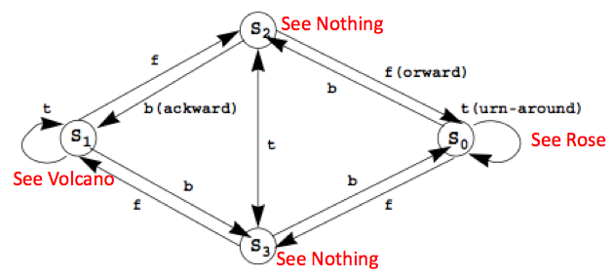
Little Prince “Action Model” (S,A,Φ,θ,π)
Transition Probabilities Φ (Forward, Back, Turn)
Appearance Probabilities θ
Initial State Probabilities π
F | S0 | S1 | S2 | S3
S0 | 0.1 | 0.1 | 0.1 | 0.7
S1 | 0.1 | 0.1 | 0.7 | 0.1
S2 | 0.7 | 0.1 | 0.1 | 0.1
S3 | 0.1 | 0.7 | 0.1 | 0.1
B | S0 | S1 | S2 | S3
S0 | 0.1 | 0.1 | 0.7 | 0.1
S1 | 0.1 | 0.1 | 0.1 | 0.7
S2 | 0.1 | 0.7 | 0.1 | 0.1
S3 | 0.7 | 0.1 | 0.1 | 0.1
T | S0 | S1 | S2 | S3
S0 | 0.7 | 0.1 | 0.1 | 0.1
S1 | 0.1 | 0.7 | 0.1 | 0.1
S2 | 0.1 | 0.1 | 0.1 | 0.7
S3 | 0.1 | 0.1 | 0.7 | 0.1
θ | Rose | Volcano | Nothing
S0 | 0.8 | 0.1 | 0.1
S1 | 0.1 | 0.8 | 0.1
S2 | 0.1 | 0.1 | 0.8
S3 | 0.1 | 0.1 | 0.8
π | S0 | S1 | S2 | S3
 | .25 | .25 | .25 | .25

Slide 6
Little Prince in Action
E_{1:T}
{rose}, fward, {none}, …, turn, {rose}, back, {volcano}
time
S1 S2 S3 S4
S1 S2 S3 S4
S1 S2 S3 S4
S1 S2 S3 S4
Hidden!
……
Given: “experience” E_{1:T} (time 1 through T)
You can Infer:
P(X_{t}|E_{1:t}), where (which state) am I at now? (estimation)
P(X_{t+k}|E_{1:t}), where I will be at time t+k? (prediction)
P(X_{k}|E_{1:t}), where I was at time k < t ? (smooth)
P(X_{1:t}|E_{1:t}) the probability of every state sequence that I went through? (explanation)
P(x_{1:t}|E_{1:t}) the most likely sequence of states I went through? (Viterbi algorithm)

Slide 7
Possible Inferences from Experience E_{1:t}
P(X_{1:t}|E_{1:t})
what states I have been through (”explanation”)
P(X_{t}|E_{1:t})
which state I am in now (“state estimation” “localization”)
P(X_{t+k}|E_{1:t})
which state I will be in at time t+k (“prediction”)
P(X_{k}|E_{1:t})
which state I was in at time k (k<t) (“smoothing”)
P(M_{t}|E_{1:t})
How correct is my model at time t (“model learning”)

Slide 8
P(X|E) Example
Given: “experience” E_{1:2}={rose, forward, nothing}
Infer: the most likely “sequence of states” X_{1:2}
E_{1:2}={rose, forward, nothing}
O_{1:2}={rose, nothing} // observations
A₁={forward} // action sequence
E_{1:2}=O_{1:2}A₁
E= {rose}, forward, {nothing}
S0 S1 S2 S3
S0 S1 S2 S3
Compute P(X|E):
16 possible X, which one is most likely?
{s0,s0}, {s0,s1}, {s0,s2}, {s0,s3},
{s1,s0}, {s1,s1}, {s1,s2}, {s1,s3},
{s2,s0}, {s2,s1}, {s2,s2}, {s2,s3},
{s3,s0}, {s3,s1}, {s3,s2}, {s3,s3}
Find the “best sequence of states” that support the experience !

Slide 9
P(X|E) Example in a Graph
P(X|E)
X
{s0,s0}
{s0,s1}
{s0,s2}
{s0,s3}
{s1,s0}
{s1,s1}
{s1,s2}
{s1,s3}
{s2,s0}
{s2,s1}
{s2,s2}
{s2,s3}
{s3,s0}
{s3,s1}
{s3,s2}
{s3,s3}

Slide 10


Compute P(X_{1:T}|E_{1:T})
E={rose, forward, nothing}
O={rose, nothing} // observations
A={forward} // action sequence
P(X_{1:T}|E) where E=OA
X_{1:T} is all possible sequences of states
Let x={i₁, i₂, …, i_{T}} be a sequence of states
P(x|E) = p(xE)/P(E) = P(xOA)/P(OA) = p(x|A)p(O|xA)/p(O|A)
p(x|A)=
p(O|xA)=
{s0,s0}, {s0,s1}, {s0,s2}, {s0,s3},
{s1,s0}, {s1,s1}, {s1,s2}, {s1,s3},
{s2,s0}, {s2,s1}, {s2,s2}, {s2,s3},
{s3,s0}, {s3,s1}, {s3,s2}, {s3,s3}
O = {z₁, z₂, …, z_{T}}, A = {b₁, b₂, …, b_{T-1}}, x = {i₁, i₂, …, i_{T}}

Slide 11
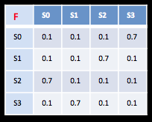

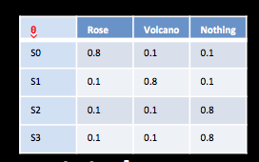
In Our Example
16 possible x
p(x|A)
p({s₀,s₀}|{f})=π(s₀)p_{s0,s0}(f)=.25*.1=.025
p({s₀,s₁}|{f})=π(s₀)p_{s0,s1}(f)=.25*.1=.025
p({s₀,s₂}|{f})=π(s₀)p_{s0,s2}(f)=.25*.1=.025
p({s₀,s₃}|{f})=π(s₀)p_{s0,s3}(f)=.25*.7=.175
p({s₁,s₀}|{f})=π(s₁)p_{s1,s0}(f)=.25*.1=.025
p({s₁,s₁}|{f})=π(s₁)p_{s1,s1}(f)=.25*.1=.025
p({s₁,s₂}|{f})=π(s₁)p_{s1,s2}(f)=.25*.1=.175
p({s₁,s₃}|{f})=π(s₁)p_{s1,s3}(f)=.25*.7=.025
p({s₂,s₀}|{f})=π(s₂)p_{s2,s0}(f)=.25*.1=.175
p({s₂,s₁}|{f})=π(s₂)p_{s2,s1}(f)=.25*.1=.025
p({s₂,s₂}|{f})=π(s₂)p_{s2,s2}(f)=.25*.1=.025
p({s₂,s₃}|{f})=π(s₂)p_{s2,s3}(f)=.25*.7=.025
p({s₃,s₀}|{f})=π(s₃)p_{s3,s0}(f)=.25*.1=.025
p({s₃,s₁}|{f})=π(s₃)p_{s3,s1}(f)=.25*.1=.175
p({s₃,s₂}|{f})=π(s₃)p_{s3,s2}(f)=.25*.1=.025
p({s₃,s₃}|{f})=π(s₃)p_{s3,s3}(f)=.25*.7=.025
{s0,s0}, {s0,s1}, {s0,s2}, {s0,s3},{s1,s0}, {s1,s1}, {s1,s2}, {s1,s3},
{s2,s0}, {s2,s1}, {s2,s2}, {s2,s3},{s3,s0}, {s3,s1}, {s3,s2}, {s3,s3}
p(O|xA)
Θs₀(r) Θs₀(n)=.8*.1=.08
Θs₀(r) Θs₁(n)=.8*.1=.08
Θs₀(r) Θs₂(n)=.8*.8=.64
Θs₀(r) Θs₃(n)=.8*.8=.64
Θs₁(r) Θs₀(n)=.1*.1=.01
Θs₁(r) Θs₁(n)=.1*.1=.01
Θs₁(r) Θs₂(n)=.1*.8=.08
Θs₁(r) Θs₃(n)=.1*.8=.08
Θs₂(r) Θs₀(n)=.1*.1=.01
Θs₂(r) Θs₁(n)=.1*.1=.01
Θs₂(r) Θs₂(n)=.1*.8=.08
Θs₂(r) Θs₃(n)=.1*.8=.08
Θs₃(r) Θs₀(n)=.1*.1=.01
Θs₃(r) Θs₁(n)=.1*.1=.08
Θs₃(r) Θs₂(n)=.1*.8=.08
Θs₃(r) Θs₃(n)=.1*.8=.08
E={rose, forward, nothing}
O={rose, nothing}, A={forward}
Best Explanation is: {s0, s3}

Slide 12
Which Explanation is the Best?
Among all possible sequences of states, the best “explanation” is the sequence of states that gives the maximal value for
Experience:
Observations: o₁, o₂, …, o_{T-1}, o_{T}
Actions: b₁, b₂, …, b_{T-1}
Sensor models:
Action models: P_{ij}[b] = P(s_{j} | s_{i}, b)
Explanation: State sequence: i₁, i₂, i₃, …, i_{T}

Slide 13
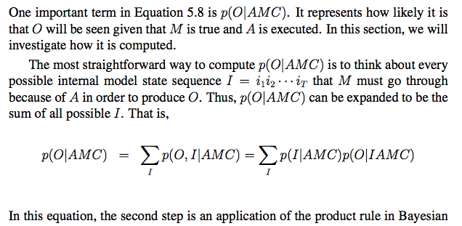
Compute Hidden State Sequence (1)
Experience consists of both O and A
O is observation sequence and A is action sequence in experience
M is the model, C is the background information
O = {z₁, z₂, …, z_{T}}, A = {b₁, b₂, …, b_{T-1}}, I = {i₁, i₁, …, i_{T}}
In Little Prince Example: I used “x” for “I”, and ignored M and C there.

Slide 14
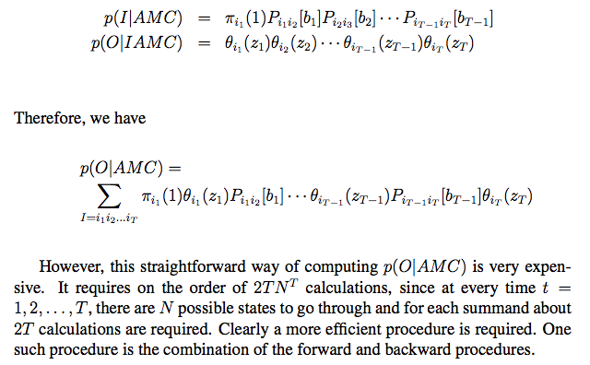
Compute Hidden State Sequence (2)
O = {z₁, z₂, …, z_{T}}, A = {b₁, b₂, …, b_{T}}, I = {i₁, i₁, …, i_{T}}
In Little Prince Example, I wrote above as p(x|A) and p(O|xA)
Among all possible sequences in I, there is one with the maximal probability.

Slide 15
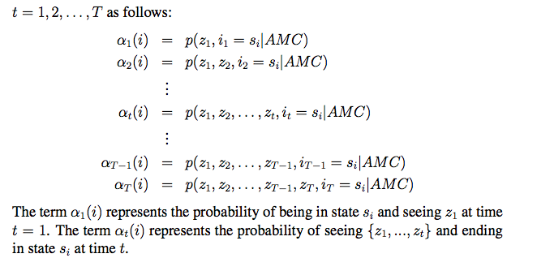
P(O|AMC) by Forward Procedure
Main idea: not consider all possible state sequence, but every step in the experience and compute P(O|AMC) incrementally on the time t:

Slide 16
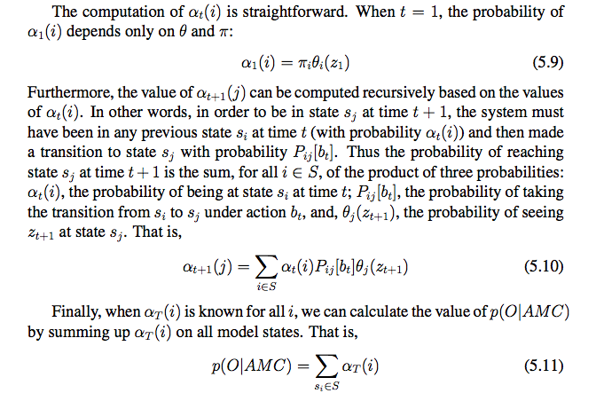
Forward Procedure
Forward Procedure
Complexity is O(TN²)

Slide 17
Forward Procedure Example
Time: t₁--------------------------------------t₂------------------------------------------ t₃-------------
E = { rose, forward, none, turn, volcano, …..}
α₂(i):
α₂(s₀) = α₁(s₀) p_{s0,s0}(f) Θs₀(n)
+ α₁(s₁) p_{s1,s0}(f) Θs₀(n)
+ α₁(s₂) p_{s2,s0}(f) Θs₀(n)
+ α₁(s₃) p_{s3,s0}(f) Θs₀(n)
α₂(s₁) = α₁(s₀) p_{s0,s1}(f) Θs₁(n)
+ α₁(s₁) p_{s1,s1}(f) Θs₁(n)
+ α₁(s₂) p_{s2,s1}(f) Θs₁(n)
+ α₁(s₃) p_{s3,s1}(f) Θs₁(n)
α₂(s₂) = α₁(s₀) p_{s0,s2}(f) Θs₂(n)
+ α₁(s₁) p_{s1,s2}(f) Θs₂(n)
+ α₁(s₂) p_{s2,s2}(f) Θs₂(n)
+ α₁(s₃) p_{s3,s2}(f) Θs₂(n)
α₂(s₃) = α₁(s₀) p_{s0,s3}(f) Θs₃(n)
+ α₁(s₁) p_{s1,s3}(f) Θs₃(n)
+ α₁(s₂) p_{s2,s3}(f) Θs₃(n)
+ α₁(s₃) p_{s3,s3}(f) Θs₃(n)
α₃(i):
α₃(s₀) = α₂(s₀) p_{s0,s0}(t) Θs₀(v)
+ α₂(s₁) p_{s1,s0}(t) Θs₀(v)
+ α₂(s₂) p_{s2,s0}(t) Θs₀(v)
+ α₂(s₃) p_{s3,s0}(t) Θs₀(v)
α₃(s₁) = α₂(s₀) p_{s0,s1}(t) Θs₁(v)
+ α₂(s₁) p_{s1,s1}(t) Θs₁(v)
+ α₂(s₂) p_{s2,s1}(t) Θs₁(v)
+ α₂(s₃) p_{s3,s1}(t) Θs₁(v)
α₃(s₂) = α₂(s₀) p_{s0,s2}(t) Θs₂(v)
+ α₂(s₁) p_{s1,s2}(t) Θs₂(v)
+ α₂(s₂) p_{s2,s2}(t) Θs₂(v)
+ α₂(s₃) p_{s3,s2}(t) Θs₂(v)
α₃(s₃) = α₂(s₀) p_{s0,s3}(t) Θs₃(v)
+ α₂(s₁) p_{s1,s3}(t) Θs₃(v)
+ α₂(s₂) p_{s2,s3}(t) Θs₃(v)
+ α₂(s₃) p_{s3,s3}(t) Θs₃(v)
α₁(i):
α₁(s₀) = π(s₀)Θs₀(r)=.25*.8=.20
α₁(s₁) = π(s₁)Θs₁(r)=.25*.1=.025
α₁(s₂) = π(s₂)Θs₂(r)=.25*.1=.025
α₁(s₃) = π(s₃)Θs₃(r)=.25*.1=.025

Slide 18
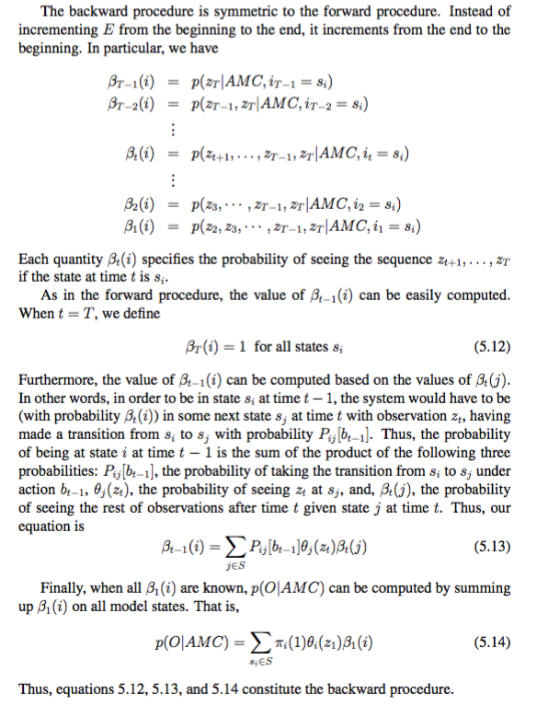
Backward Procedure
Similar to forward
See ALFE 5.10.1

Slide 19
Inference: State Estimation
P(X_{t}|E_{1:t})
Which state I am most likely in now?
It is the state s_{i} such that α_{T}(i) is the maximal
Viterbi algorithm is for this.

Slide 20
Inference: State Prediction
P(X_{t+k}|E_{1:t})
which state I will be in at time t+k?
Depending on your action during (t, t+k]
If you have an non-action, use that information and continue computing the future α values.
Example/exercise: compute when k=1, k=2, …

Slide 21
Inference: State Smoothing
P(X_{k}|E_{1:t})
which state I was in at time k (smoothing)
It is the state s_{i} such that α_{k}(i) P_{ij}(b_{k+1}) θ_{j}(z_{k+1}) β_{k+1}(j) is the maximal
This is to say, given time 1,…,k, k+1, ...,t
(best forward from 1 to k) + (best transition from k to k+1) + (best backward to k+1 from t)

Slide 22
State Explanation
P(X_{1:t}|E_{1:t})
what states I have been through (explanation)
They are the following states:
t=1: the state s_{i} such that α₁(i) is the maximal
t=2: the state s_{i} such that α₂(i) is the maximal
t=T: the state s_{i} such that α_{T}(i) is the maximal

Slide 23
Model Learning
P(M_{t}|E_{1:t})
How correct is my model of the world (learning)
We will teach you this in session 26.

Slide 24
Exercise for you
Given: the Little Prince (see slide 3)
His sensor model (you fill in the rest)
His action model (you fill in the rest)
Assume he had the following experience
Observations: {rose, nothing, volcano, nothing}
Actions: {forward, turn, backward, backward}
Compute:
P(X₁|E₁), P(X₂|E_{1:2}), P(X₃|E_{1:3}),
P(X_{1:3}|E_{1:3})
P(X₄|E_{1:3})

Slide 25
Other Temporal Models
Markov Chains
No observation, no explicit actions, transit randomly
Hidden Markov Model
No explicit actions, state transit randomly
Continuous State Model
No explicit actions, States are continuous
Dynamic Bayesian Networks
No explicit actions, States are Bayesian Networks
POMDP

Slide 26
Hidden Markov Models
Markov chains not so useful for most agents
Eventually you don’t know anything anymore
There is no observations available to update your beliefs
Hidden Markov models (HMMs)
Underlying Markov chain over states S
You observe outputs (effects) at each time step
As a Bayes’ net:
Hidden States
X₁
X₂
X₃
X₄
X₅
Evidence
E₁
E₂
E₃
E₄
E₅

Slide 27

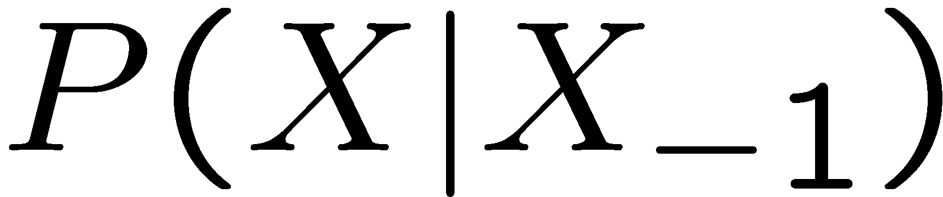
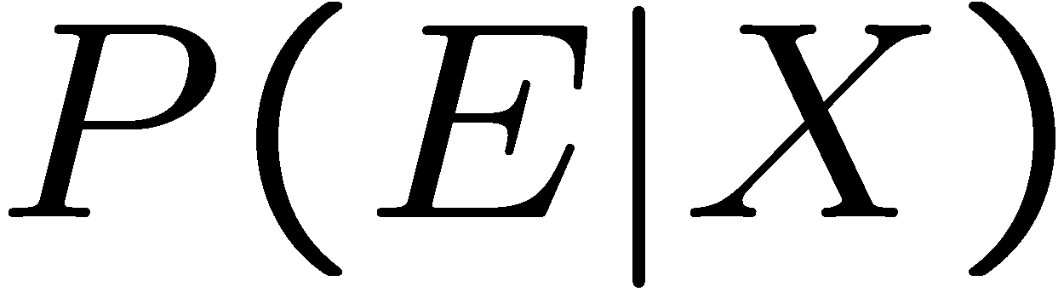
Rain/Umbrella Example in the Book
An HMM is defined by:
Initial state distribution:
Transitions:
Emissions (sensor model):

Slide 28
Ghostbuster HMM Example
Initial state distribution P(X₁) = uniform
Transition of the ghost P(X’|X) = usually move clockwise, but sometimes move in a random direction or stay in place
P(R_{ij}|X) = the same sensor model as before: red means close, green means far away.
1/9
1/9
1/9
1/9
1/9
1/9
1/9
1/9
1/9
P(X₁)
1/6
1/6
1/2
X₁
X₂
X₃
X₄
0
1/6
0
0
0
0
R_{i,j}
R_{i,j}
R_{i,j}
R_{i,j}
P(X’|X=<1,2>)
See ghost
Not see ghost

Slide 29
Markov Assumption and Conditional Independence
HMMs have two important independence properties (these are also referred to as the Markov Assumption):
The future state depends only on the current state and nothing else
The current observation depends only on the current state and nothing else
Quiz: does this mean that observations are independent?
[No, correlated by the hidden state]
X₁
X₂
X₃
X₄
E₁
E₂
E₃
E₄

Slide 30
Some HMM Applications
Speech recognition HMMs:
Observations are acoustic signals (continuous valued)
States are specific positions in specific words (so, tens of thousands)
Machine translation HMMs:
Observations are words (tens of thousands)
States are translation options
Robot tracking:
Observations are range readings (continuous/discrete)
States are positions on a map (continuous/discrete)

Slide 31
Filtering / Monitoring
Filtering, or monitoring, is the task of tracking the distribution P(X) (the belief state) over time
We start with P(X) in an initial setting, usually uniform
As time passes, or we get observations, we update P(X)
P(X_{t}|E_{1:t})

Slide 32
Example: Robot Localization
Example from Michael Pfeiffer
State X: Room
0
1
Initially (t=0): before sensing, all states are equally likely
Sensor model: never more than 1 mistake
Motion model: may not execute action with small prob.

Slide 33
Example: Robot Localization
Prob
0
1
t=1 (sensing: no room up or down)

Slide 34
Example: Robot Localization
Prob
0
1
t=2

Slide 35
Example: Robot Localization
Prob
0
1
t=3

Slide 36
Example: Robot Localization
Prob
0
1
t=4

Slide 37
Example: Robot Localization
Prob
0
1
t=5

Slide 38
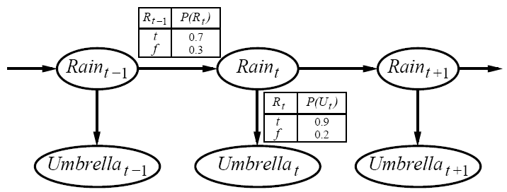
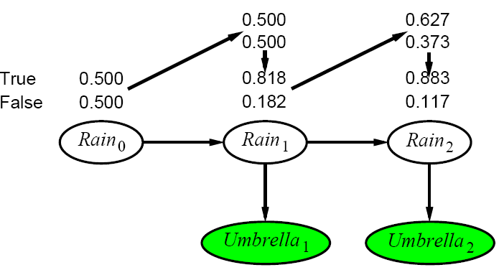
Another Filtering Example
Day 0:
P(R₀)=<0.5,0.5>
Day 1 (Umbrella appears ➔ U₁=true)
P(R₁)=P(r₀)P(R₁|r₀)
= α0.5<0.7,0.3> + α0.5<0.3,0.7>
= <0.5,0.5>
updating with evidence for t=1 gives:
P(R₁|u₁)=αP(u₁|R₁)P(R₁)=α<0.9,0.2><0.5,0.5>
=α<0.45,0.1> = <0.818,0.182>
Day 2 (Umbrella appears ➔ U₂=true)
P(R₂|u₁)= P(R₂|r₁)P(r₁|u₁)
=α<0.818<0.7,0.3> + 0.182<0.3,0.7>> = <0.627,0.373>
updating with evidence for t=2 gives:
P(R₂|u₁,u₂)=αP(u₂|R₂)P(R₂|u₁)=α<0.9,0.2><0.627,0.373>
=α<0.565,0.075> = <0.883,0.117>

Slide 39
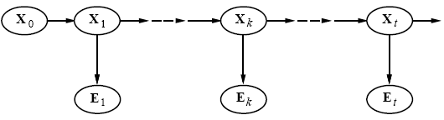
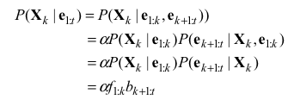

Smoothing P(X_{k}|E_{1:t})
Divide evidence e_{1:t} into e_{1:k}, e_{k+1:t} :
Backward message computed by a backwards recursion:
Using Bayes rule
Using conditional independence
Conditioning on X_{k+1}
Using conditional independence
= Backward(b_{k+2:t},e_{k+1:t})
b_{k+1:t} = Σ_{Xt+1}[P(e_{k+1}|x_{k+1})P(x_{k+1}|X_{k})] b_{k+2:t}

Slide 40
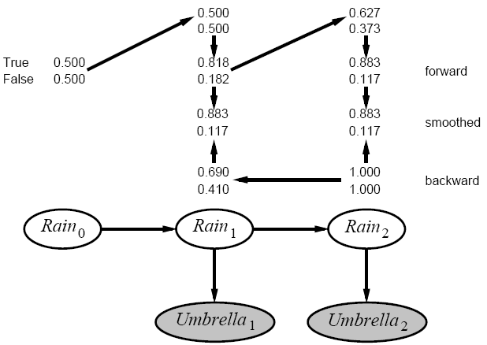
Smoothing Example
Compute estimate for rain at t=1
P(R₁|u₁,u₂)=αP(R₁|u₁)P(u₂|R₁)
P(R₁|u₁) = <0.818,0.182>
P(u₂|R₁) =Σ_{r2}P(u₂|r₂)P(r₂)P(r₂|R₁)
=(0.9 ✕ 1 ✕ <0.7,0.3>) + (0.2 ✕ 1 ✕ <0.3,0.7>)
= <0.69,0.41>
Smoothed estimate:
P(R₁|u₁,u₂)=α<0.818,0.182> ✕ <0.69,0.41> = <0.883,0.117>
Forward-backward algorithm: cache forward messages along the way
Time linear in t (polytree inference), space O(t_{j}f_{j})

Slide 41
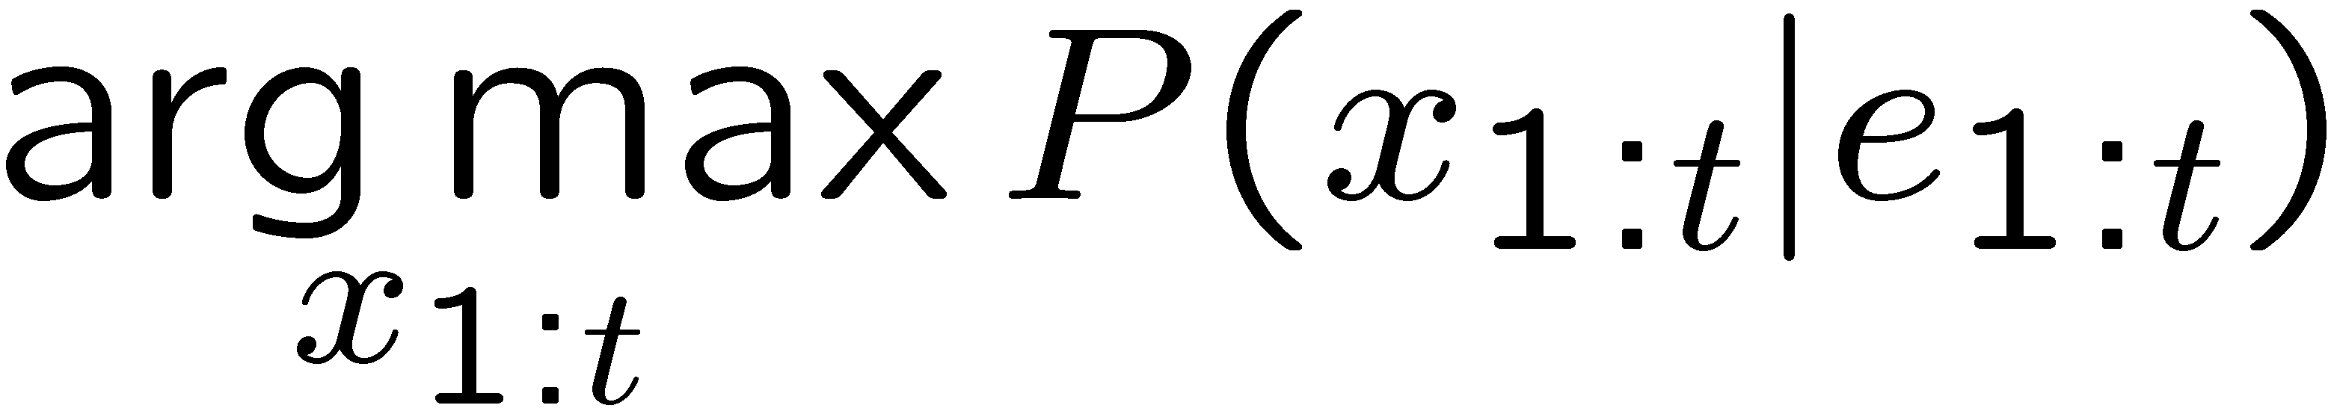
Query for Best Explanation: P(X_{1:T}|E_{1:T})
X₁
X₂
X₃
X₄
X₅
E₁
E₂
E₃
E₄
E₅
Query: most likely sequence of states:

Slide 42
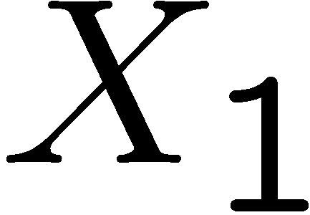
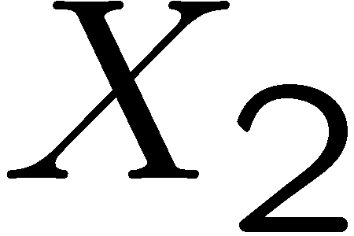

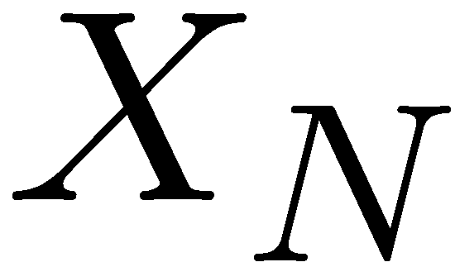
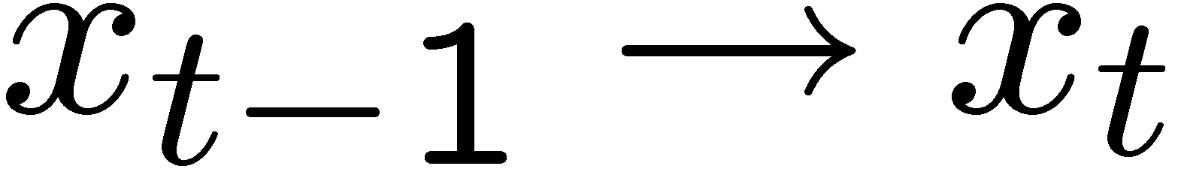
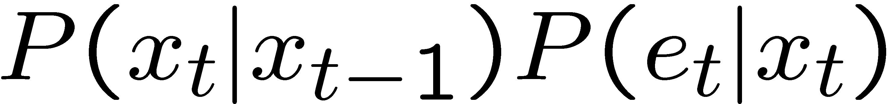
State Path Trellis
State trellis: graph of states and transitions over time
Each arc represents some transition
Each arc has weight
Each path is a sequence of states
The product of weights on a path is the sequence’s probability
Can think of the Forward (and now Viterbi) algorithms as computing sums of all paths (best paths) in this graph
sun
sun
sun
sun
rain
rain
rain
rain

Slide 43
Viterbi Algorithm for P(X_{1:T}|E_{1:T}): choose the best explanation state sequence Similar to α_{t}(s_{t}) on slide 14, but use max not sum
sun
sun
sun
sun
rain
rain
rain
rain
α_{t}(s_{t})
α_{t-1}(s_{t-1})

Slide 44
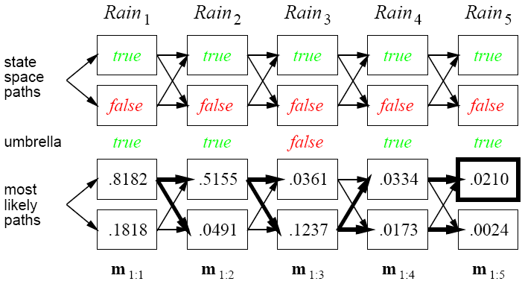
Viterbi Example P(R_{1:5}|U_{1:5})

Slide 45
Viterbi Example: P(R_{1:5}|U_{1:5})
0.8182*0.7 *0.9
0.5155*0.7 *0.1
0.1237*0.3 *0.9
0.0334*0.7 *0.9
0.8182*0.3 *0.1
0.5155*0.3 *0.8
0.1237*0.7 *0.1
0.0173*0.7 *0.1

Slide 46
Other Temporal Models
Markov Chains
No observation, no explicit actions, transit randomly
Hidden Markov Model
No explicit actions, state transit randomly
Dynamic Bayesian Networks
No explicit actions, States are Bayesian Networks
Continuous State Model
No explicit actions, States are continuous
POMDP

Slide 47
Dynamic Bayesian Networks
{evidence}, action, {evidence}, …, action, …, {evidence}, action, {evidence}
S1 S2 S3 S4
S1 S2 S3 S4
S1 S2 S3 S4
S1 S2 S3 S4
……
………
Each time “slice” is a Bayesian Network with variables and CPTs

Slide 48
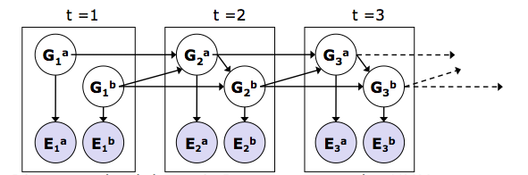
Dynamic Bayes Nets (DBNs)
Track multiple variables over time, using multiple sources of evidence
Key Idea: Repeat a fixed Bayes net structure at each time
Variables from time t can condition on those from t-1
Discrete valued dynamic Bayesian nets are also HMMs

Slide 49
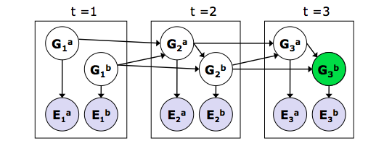
Exact inference in DBNs
Variable elimination applies to Dynamic Bayesian nets
Procedure: “unroll” the network for T time steps, then eliminate variables until P(X_{T}|e_{1:T}) is computed
Online belief updates: Eliminate all variables from the previous time step; store factors for current time only

Slide 50

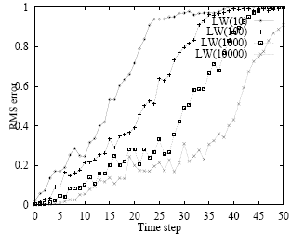
Likelihood Weighting for DBNs
Set of weighted samples approximates the belief state
LW samples pay no attention to the evidence!
* fraction “agreeing” falls
exponentially with t
* num. samples required
grows exponentially with t

Slide 51
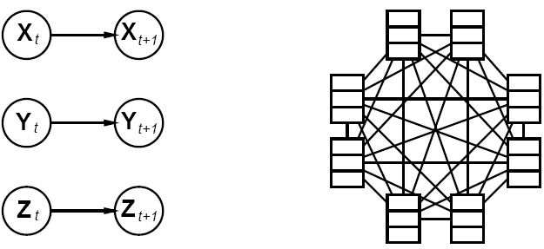
DBNs vs. HMMs
Every HMM is a single-variable DBN;
every discrete DBN is an HMM
Sparse dependencies: exponentially fewer parameters;
e.g., 20 state variables, three parents each
DBN has 20x2³ =160 parameters, HMM has 2²⁰x2²⁰ ¼10¹²

Slide 52
Other Temporal Models
Markov Chains
No observation, no explicit actions, transit randomly
Hidden Markov Model
No explicit actions, state transit randomly
Dynamic Bayesian Networks
No explicit actions, States are Bayesian Networks
Continuous State Model
No explicit actions, States are continuous
POMDP

Slide 53
Kalman Filters
{evidence}, action, {evidence}, …, action, …, {evidence}, action, {evidence}
S1 S2 S3 S4
S1 S2 S3 S4
S1 S2 S3 S4
S1 S2 S3 S4
……
………
In each time slice, state variables are continuous (not discrete)

Slide 54
Summary
Temporal models use states, transitions, sensors
Transitions may related to agent’s actions, or spontaneous
Markov assumptions and stationary assumption
- transition model P(Xt | Xt-1) or P(Xt | Xt-1, a_{t-1})
- sensor model P(Et | Xt)
Tasks: filtering, prediction, smoothing, most likely seq
all done recursively with constant cost per time step
Types of models
HMM have a single discrete state variable
Dynamic Bayes nets subsume HMMs; exact update intractable
Other models may have internal structure driven by actions

